Slide 1

Review-2 on
CLIMATE CHANGE ANALYSIS
C Koushik Reddy (2010030027)
D Chaitanya (2010030045)
TSS Subramanyam (2010030167)
PS Yeshwanth (2010030122)
Under the Guidance of
MR Vijay Kumar
Professor
Computer Science and Engineering Department
KL Hyderabad Off Campus, Aziz Nagar ,Hyderabad

Slide 2
Overview
Introduction
Objectives of the Project
Proposed Methodology/Architecture/Algorithm/Technique/etc
Implementation Details
Results
References

Slide 3
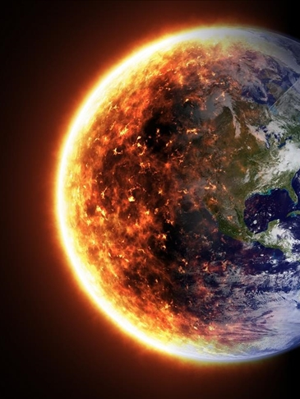
INTRODUCTION
Global environmental change is more extreme than at any other time in recorded history. Its local realities increasingly uproot large numbers of people. Global climate change is increasingly accepted by both the scientific community and the general public as a reality that must be addressed in both policy and practice. The recent reports from the Intergovernmental Panel on Climate Change affirm that human-induced factors are responsible for generating significant increases in temperatures around the world. The environmental degradation of local ecosystems compounded by the local effects of global climate change can result in the loss of sufficient resources and other ecosystem services.

Slide 4
Problem Statement
Air pollution will directly impact on humans.Also long term exposure to
particular air polluntants may also cause cancer.
Also because of air pollution there will be adverse effects on climate change
Visibility and Aesthetics,Social and Economic Implications,Regulatory Compliance and Policy Development:Environmental Impact.

Slide 5

CAUSES
Shrinking mountain glaciers due to pollution
Emission of green House gases
Deforestation or forest clearance
Production of excess amount of nitrous oxide emissions by fertilizers containing nitrogen

Slide 6
Literature Review
S.no | Title | Author | Description
1 | Forecasts the daily AQI | Anikender Kumar, PramilaGoyal | presented the study that forecasts the daily AQI value for the city Delhi, India using previous record of AQI and meteorological parameters with the help of Principal Component Regression (PCR) and Multiple Linear Regression Techniques. They perform the prediction of daily AQI of the year 2006 using previous records of the year 2000-2005 and different equations.
2 | AIR Quality | Huixiang Liu | They have taken two different cities Beijing and Italian city for the study purpose. They have forecasted the Air Quality Index (AQI) for the city Beijing and predicting the concentration of NOxin an Italian City depending on two different publicly available datasets.

Slide 7
Literature Review
S.no | Title | Author | Description
1 | Forecasts the hourly concentration AQI | HeidarMaleki | predicted the hourly concentration values for the ambient air pollutants NO2, SO2, PM10, PM2.5, CO and O3 for the stations Naderi, Havashenasi, MohiteZist and Behdasht in Ahvaz, Iran which is the most polluted city in the world. They have also calculated and predicted Air Quality Index (AQI) and Air Quality Health Index (AQHI) for the four air quality monitoring stations in Ahvaz mentioned above.
2 | Concentration Level in AIR | Aditya C R | Employed the machine algorithms to detect and forecast the PM2.5 concentration level on the basis of dataset containing atmospheric conditions in a specific city. They also predicted the PM2.5 concentration level for a particular date.

Slide 8
Tool : Python,Power Bi
Data pre-processing
Models : Linear Regression,SVM
Methodology

Slide 9
Project outcome
It helps in keep track of the global temperature.
These insights can help how temperature is causing global warming.
This analysis helps in understanding the potential impacts on coastal regions and low-lying areas.
It helps in assessing the risk and preparedness for unexpected disasters.

Slide 10

REFERENCES
[1] Bhattacharya, Amitav. "Global climate change and its impact on agriculture.“
Changing climate and resource use efficiency in plants (2019): 1-50.
[2] Galappaththi, Eranga K., Stephanie T. Ichien, Amanda A. Hyman, Charlotte J.
Aubrac, and James D. Ford. "Climate change adaptation in aquaculture.“
Reviews in aquaculture 12, no. 4 (2020): 2160-2176.
[3] Abbas, Shujaat. "Climate change and major crop production.“
Environmental Science and Pollution Research 29, no. 4 (2022): 5406-5414.
[4] Yeganeh, Armin Jeddi, Andrew P. McCoy, and Todd Schenk. "Determinants of climate
change policy adoption: A meta-analysis." Urban Climate 31 (2020): 100547..
[5] Fu, Hui-Zhen, and Ludo Waltman. "A large-scale bibliometric analysis of global
climate change research between 2001 and 2018." Climatic Change 170, no. 3-4
(2022): 36.
[6] Bhardwaj, Mandeep, Pushp Kumar, Siddharth Kumar, Vishal Dagar, and Ashish Kumar. "A
district-level analysis for measuring the effects of climate change on production of agricultural
crops, ie, wheat and paddy: evidence from India." Environmental Science and Pollution
Research 29, no. 21 (2022): 31861-31885..

Slide 11

Thank Q

